Slide 1

Machine Learning for Bitcoin
BAQER MOHAMMED HUSSEIN
AHMED GHALIB SAAD
ALI SAJAD NAEEM

Slide 2



Agenda
DATA COLLECTION
• Downloading Bitcoin historical data
• Using yFinance to get Open, High, Low, Close, Volume
• Adding technical indicators (SMA, EMA, RSI, MACD)
MODEL DESIGN (LSTM)
• Building an LSTM neural network
• Layers: LSTM, Dropout, Dense
MODEL TRAINING
• Splitting into training & testing sets
• Training the model for 60 epochs
• Using EarlyStopping & ModelCheckpoint
PREDICTIONS
• Predicting test prices
• Inverse-transforming predictions back to USD
• Saving predictions to CSV
• Plotting Real vs Predicted prices

Slide 3
Libraries Used in the Project
4
MATPLOTLIB
1
• Used to draw charts:
• Real vs Predicted prices
• Visualizing the model’s performance
NUMPY
• Used for fast numerical calculations.
• Helps the model handle large arrays of data.
5
SCIKIT-LEARN
2
• Provides tools for:
• Scaling data (MinMaxScaler)
• Measuring accuracy (MAE, RMSE, R²)
PANDAS
• Used to load and organize Bitcoin price data.
• Makes it easy to work with tables, dates, and indicators.
6
3
TENSORFLOW / KERAS
• The “brain” of the project.
• Used to build and train the LSTM neural network.
YFINANCE
• Downloads real Bitcoin historical prices from Yahoo Finance.
• Provides: Open, High, Low, Close, Volume.
7
OS & MATH
• OS: file saving & detecting files
• Math: calculating RMSE and other metrics

Slide 4

How the AI Model Learns (Training Process)
1) TRAINING DATA
• The model receives 90 days of Bitcoin prices + indicators as input.
• It learns to predict the next day’s Close price.
• This repeats for every day in the dataset.
2) LSTM LEARNING PROCESS
• LSTM looks for patterns over time, such as:
• Upward or downward trends
• Price momentum
• Repeated behaviors in the market
• It adjusts its internal weights every time it sees an error.
3) REDUCING ERROR
• The model makes a prediction.
• It compares prediction vs actual price.
• It calculates loss (error).
• It adjusts itself to reduce this error next time.
• This happens for 60 epochs (60 full training cycles).
4) VALIDATION
• Part of the data (20%) is used only for testing.
• This ensures the model doesn’t “memorize” data but actually learns patterns.

Slide 5

Data Source — Yahoo Finance
THE PROJECT USES REAL BITCOIN HISTORICAL DATA DOWNLOADED DIRECTLY FROM THE YAHOO FINANCE WEBSITE USING THE YFINANCE PYTHON LIBRARY.
THE DATA INCLUDES DAILY PRICE INFORMATION SUCH AS:
• OPEN: THE PRICE AT THE START OF THE DAY
• High: highest price of the day
• Low: lowest price of the day
• Close: the final price of the day
• Volume: total traded Bitcoin that day
• This data is used as the foundation for training the machine learning model and making predictions.

Slide 6

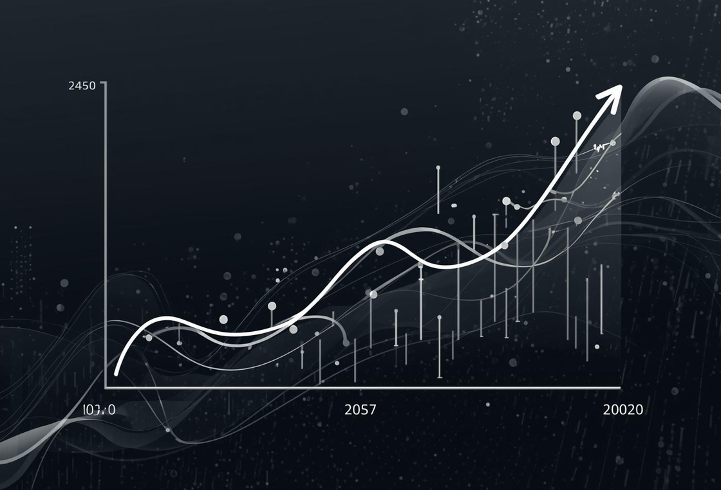
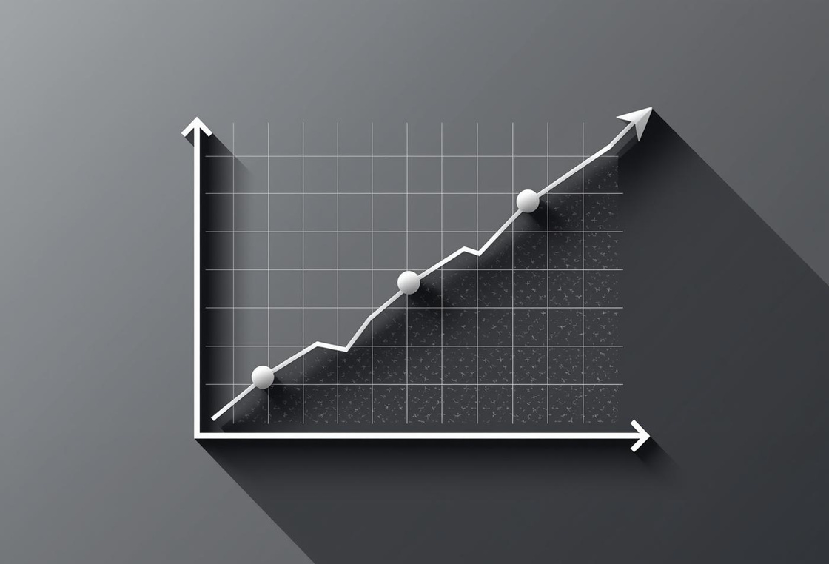
MAE (Mean Absolute Error)
RMSE (Root Mean Square Error)
R² Score (Coefficient of Determination):
• Measures how much the predicted prices differ from the real prices on average.
• Lower MAE = better predictions.
• Measures prediction error but gives extra weight to larger mistakes.
• Used widely in financial forecasting.
• Lower RMSE = better accuracy.
• Shows how well the model explains the variation in real Bitcoin prices.
• R² ranges from 0 to 1, where:
• 1 = perfect prediction,
• 0 = model learned nothing.
• Higher R² means the model fits the data better.

Slide 7
Challenges
1
2
COLLECTING AND CLEANING DATA
TRAINING THE MACHINE LEARNING MODEL
• Choosing the right model and getting a good R² score is difficult.
• The model may learn too much or too little, giving weak predictions.
• The website data may be incomplete, messy, or blocked.
• We must clean and prepare the data before using it.

Slide 8

Future Improvements
1
2
USE A MORE ADVANCED MACHINE LEARNING MODEL
DEPLOY THE MODEL AS A WEB APP
• Create an online dashboard where users can enter values
and instantly get predictions from the model.
• Replace Linear Regression with models like Random Forest or XGBoost
to improve accuracy and get a higher R² score.

Slide 9

Thank You

